Slide 1
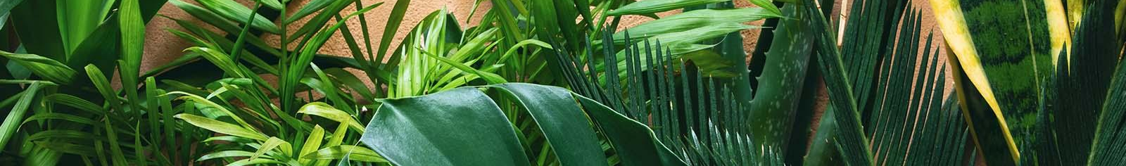


Greenhouse Environmental Analyzer
of Blue to Red Light, Humidity, Temperature, and ${CO}_{2}$
2/7/25
Critical Design Review
Group 1
Maya Sosa, PSE
Paul Weiner, PSE
Raul Graterol Medina, CPE
Leiner Suarez Colome, EE

Slide 2
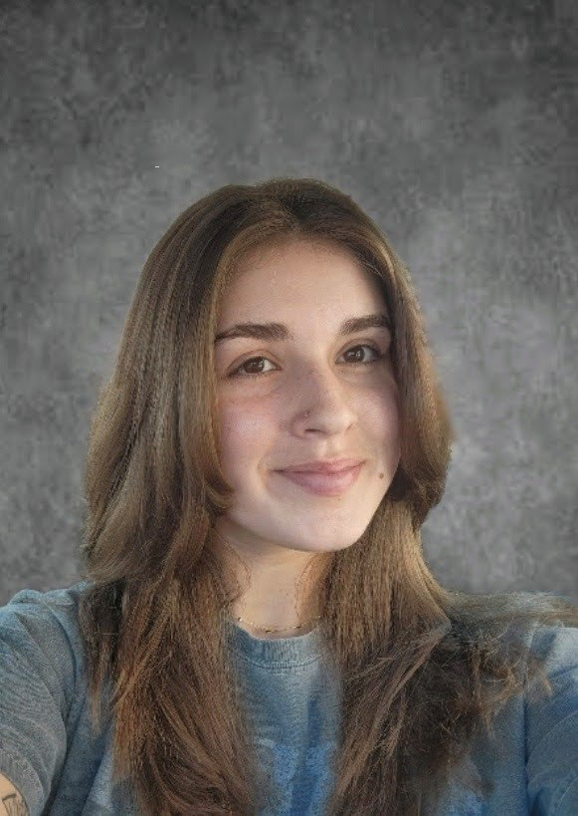
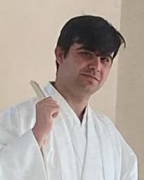

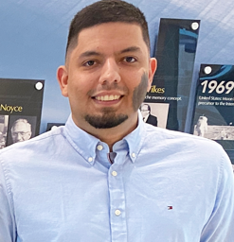
G.E.A Greenhouse Environmental Analyzer
Maya Sosa
Photonic Science and Engineering
Leiner Suarez Colome
Electrical Engineering
Paul Weiner
Photonic Science and Engineering
Raul Graterol Medina
Computer Engineering

Slide 3
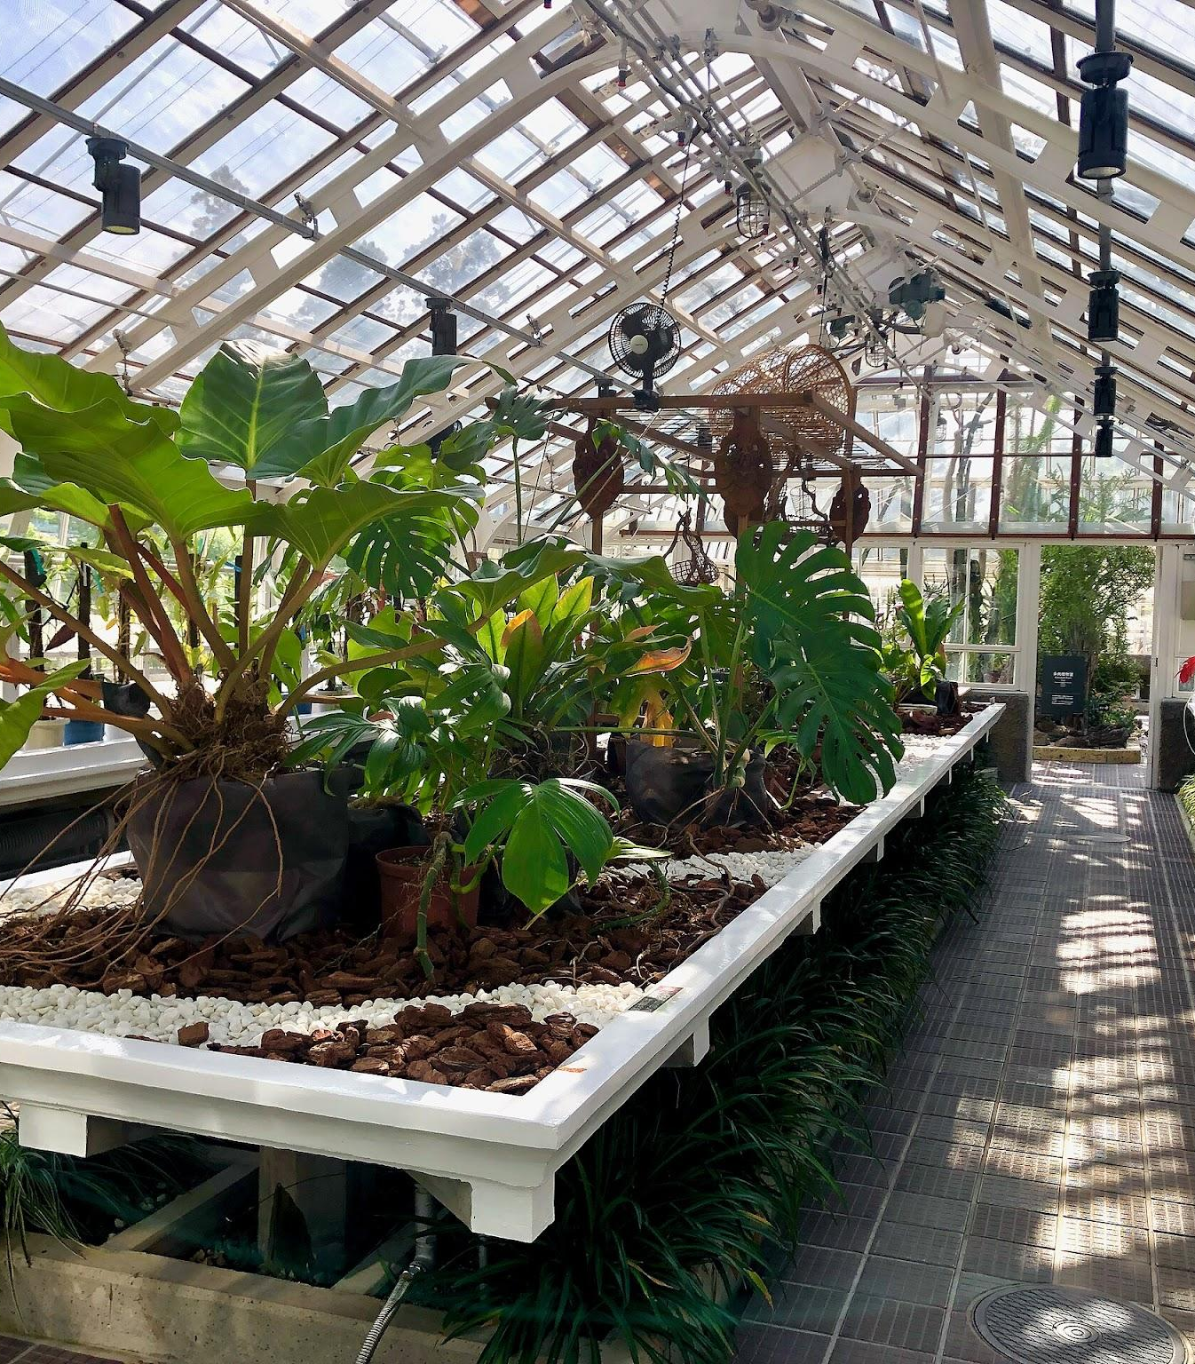
Motivation
G.E.A Greenhouse Environmental Analyzer
Maya Sosa
PSE
30,000
FARMS USING GREENHOUSES
839
“In the very sensitive and necessarily stable environment of greenhouses, there is an increased need for reliable and easy-to-use greenhouse monitoring systems.”
MILLION SQ FT OF FLORICULTURE
133
MILLION SQ FT OF FOOD CROPS
118%
INCREASE IN SQ FT OF FOOD CROPS (2017-2022)
*According to 2022 NASS Census
Notes:
National ag statistics service https://www.nass.usda.gov/Publications/AgCensus/2022/Full_Report/Volume_1%2C_Chapter_1_US/st99_1_039_039.pdf?utm_source=chatgpt.com

Slide 4
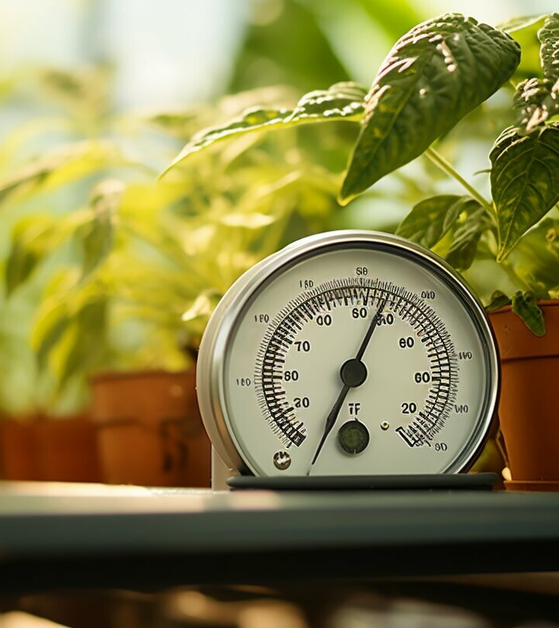
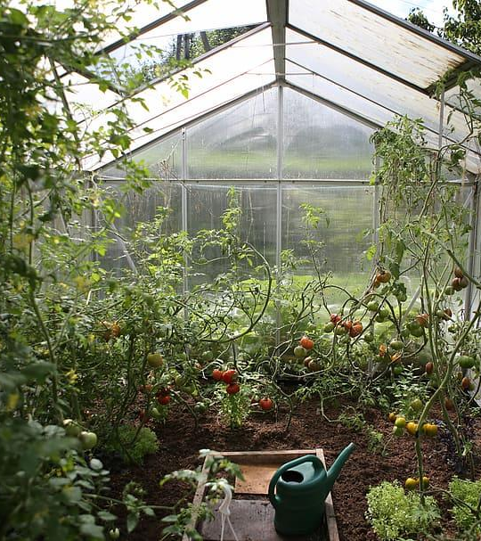
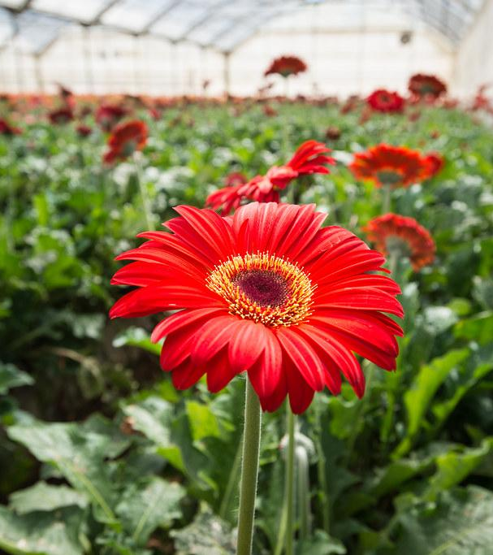
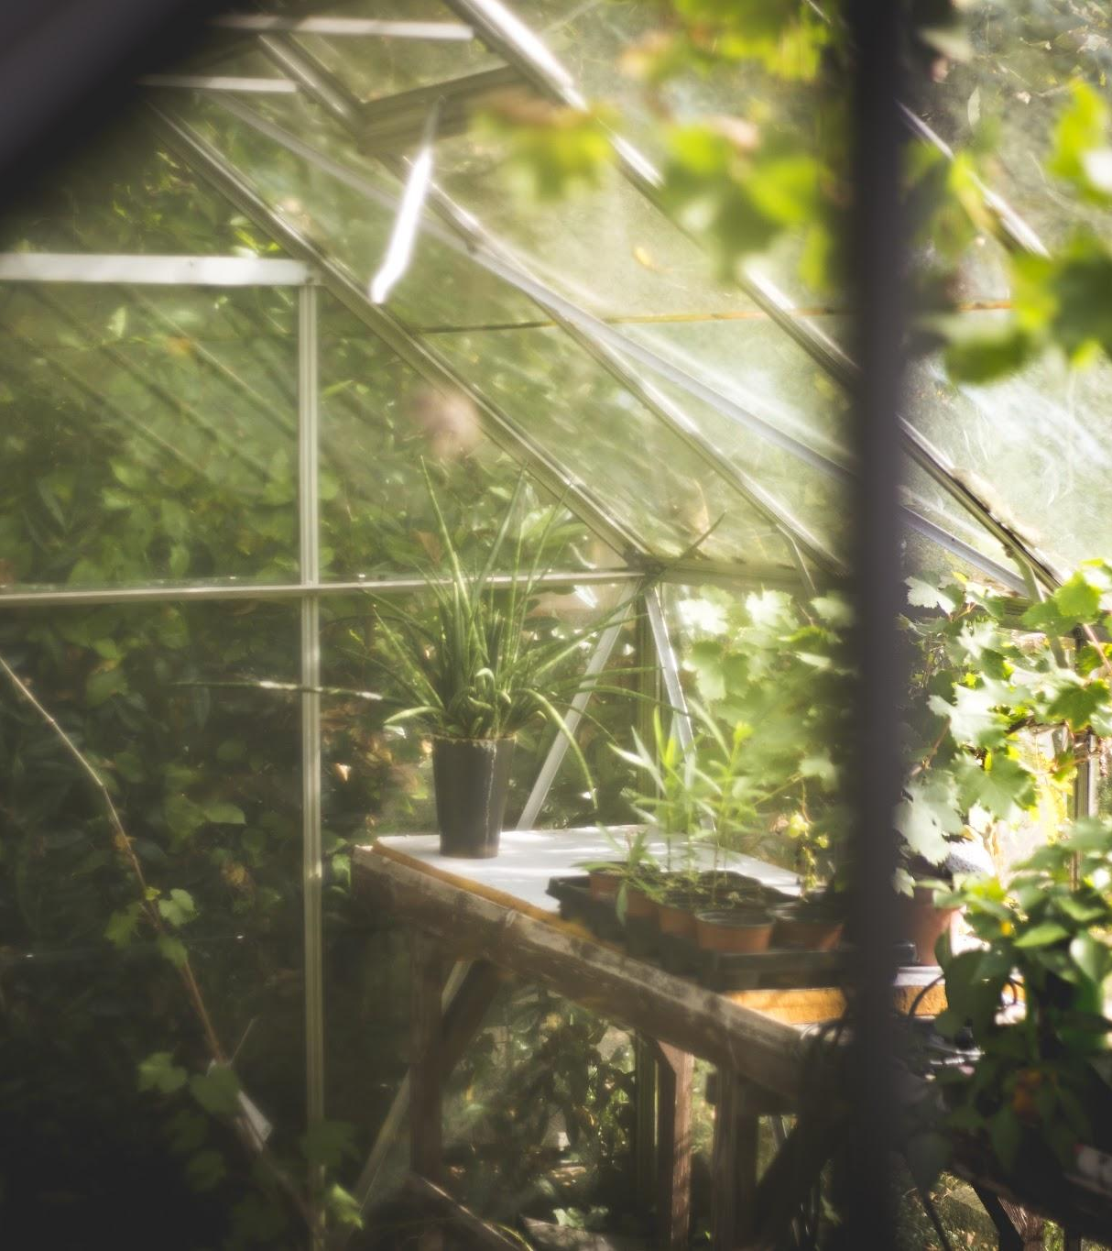
Maya Sosa
PSE
TEMPERATURE
HUMIDITY
CARBON DIOXIDE
LIGHT LEVELS
Multiple devices are typically needed to measure the metrics of light intensity, CO2, humidity, and temperature
We aim to create an all-inclusive device
Motivation

Slide 5
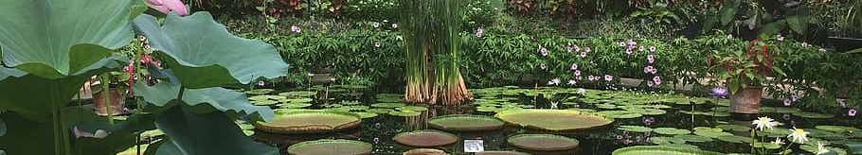
Background
G.E.A Greenhouse Environmental Analyzer
Maya Sosa
PSE
“Specific wavelengths of light such as blue (400–500 nm) and red (600–700 nm) have been shown to positively impact morphogenesis, metabolism, and the capacity for plants to photosynthesize”
Blue light effects chlorophyll production and the strength of stems and leaves while red light has an effect on the flowering/fruit production of the plant.
Trivellini, A., Toscano, S., Romano, D., & Ferrante, A. (2023). The Role of Blue and Red Light in the Orchestration of Secondary Metabolites, Nutrient Transport and Plant Quality. Plants, 12(10), 2026. https://doi.org/10.3390/plants12102026

Slide 6
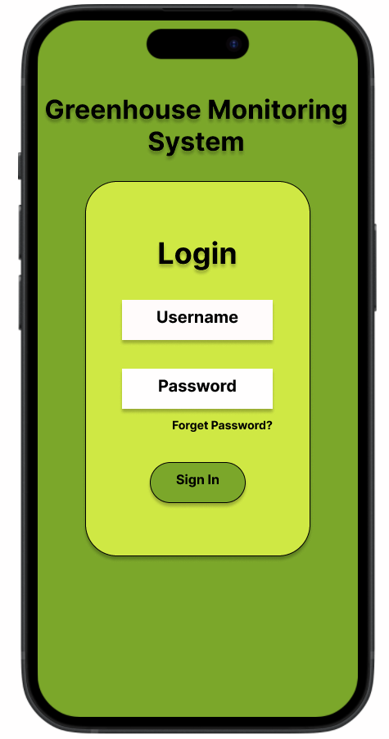
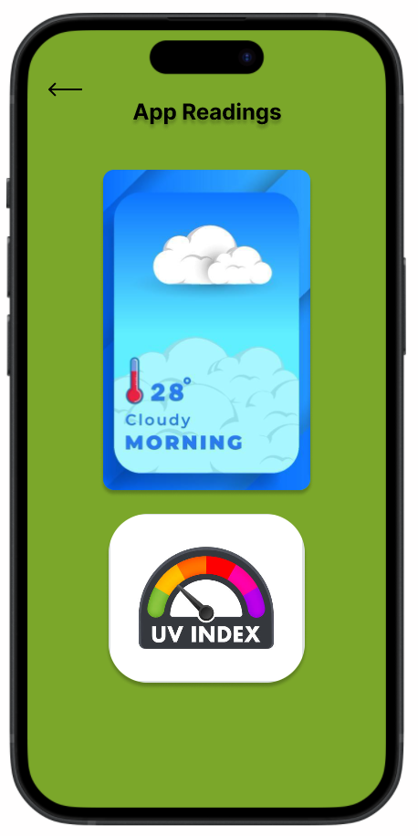
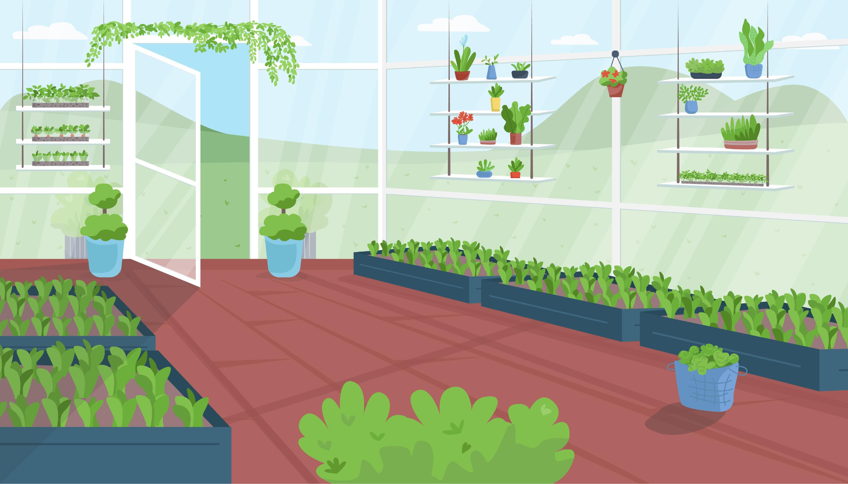

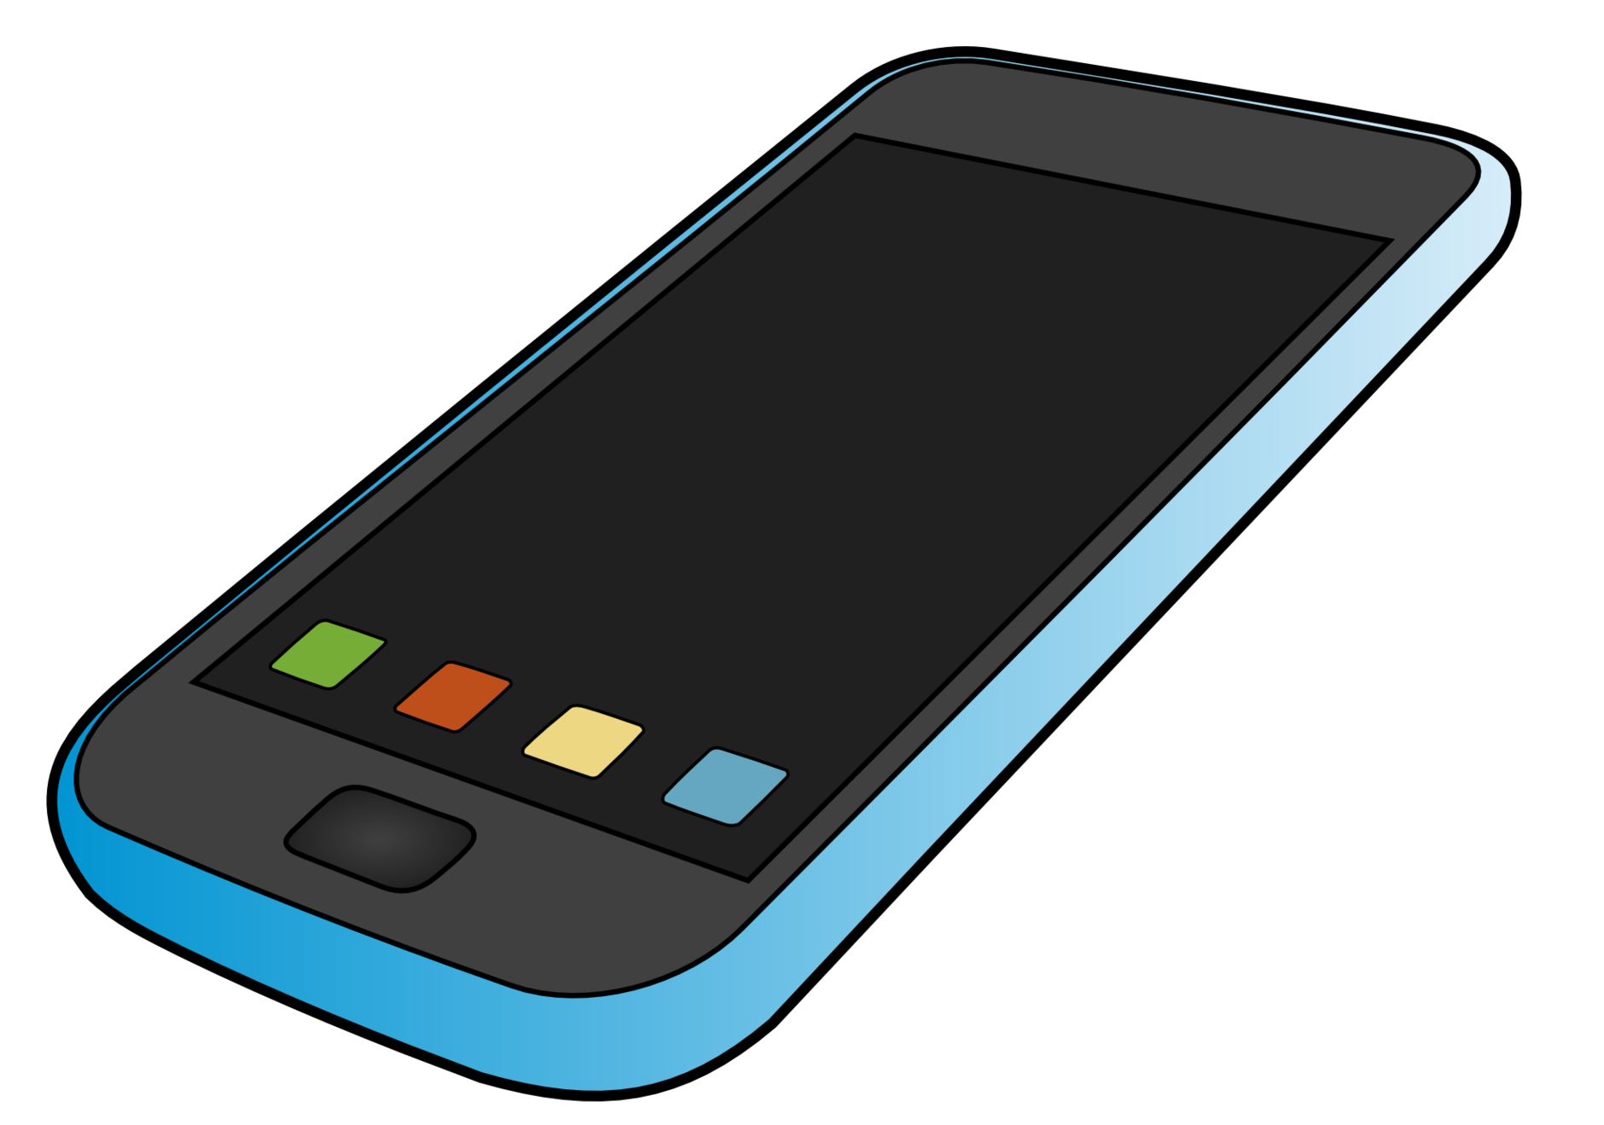
Maya Sosa
PSE
Notes:
Here is a quick visual for how we aim for our project to function. The device will be put in a greenhouse, preferably at plant canopy level, and will continuously monitor the parameters. Along with this, there will be an application that will allow for remote viewing of the metrics from your phone, and, as a streth goal, will be able to control the parameters of the greenhouse to keep the readings at the desired level. This will be talked about more in the later slides.

Slide 7
Maya Sosa
PSE
G.E.A Greenhouse Environmental Analyzer
Basic Goals | Basic Objectives | Advanced Goals | Advanced Objectives
The device will be capable of measuring temperature, humidity, and CO_{2.} | Successfully calibrate the bought sensors using separate measurements to ensure reliability and accuracy. | The CO2 measurement will be accurate within ±50 ppm. | Calibrate CO2 sensor with a separate sensor to ensure accuracy.
The device will be capable of measuring white light and the red to blue light ratio and be able to control this ratio through a LED panel. | Successfully calibrate light sensors with lenses and other optical elements to ensure overall white light intensity measurement and the ratio of blue to red light is accurate. | The temperature measurement will be accurate within ±1°C. | Calibrate temperature sensor with a separate sensor to ensure accuracy.
The measurements of these parameters will be determined and wirelessly sent to be displayed through an application. | Create a software structure, such as a user-friendly app, where the readings from the sensor will be displayed. | The red and blue light ratio measurement and LED Array adjustment will be accurate within ±10% of the intensity of each wavelength. | Calibrate red and blue photodiodes with a lux meter to ensure accuracy of ratio and ensure that the LED Array changes according to the desired ratio.
This device must be able to continuously collect data and update the application in real-time. | Ensure measurements are read after specified intervals of time to update app in real-time. | The relative humidity measurement will be accurate within ±10% RH. | Calibrate humidity sensor with a separate hygrometer to ensure accuracy.
Satisfy voltage requirements aligning with SD standards. | Implement a Power distribution network which supply voltage at +/- 10% for the 3V3 and 1V8 power reels to the sensors and the MCU. | The total dimensions of the device will not exceed 15”x15”x10”. | Create housing in a CAD software and specify measurements to not exceed the specifications before 3D printing housing

Slide 8
G.E.A Greenhouse Environmental Analyzer
Maya Sosa
PSE
Stretch Goals | Stretch Objectives
The data collected through this device will be used to predict greenhouse status dependent upon the type of plants inside | Create option to input type of plant within greenhouse and use data analysis of the readings to predict plant health
The application will be able to analyze the data and determine parameters that must change for optimal plant health | Establish a firmware/hardware that allows the dispositive to understand the data and analyze it to determine the changes needed within the greenhouse
The data gathered by the device will be able to physically adjust to the environmental needs of the greenhouse | Send signals from the device to the greenhouse itself to adjust the parameters however it determines is necessary

Slide 9
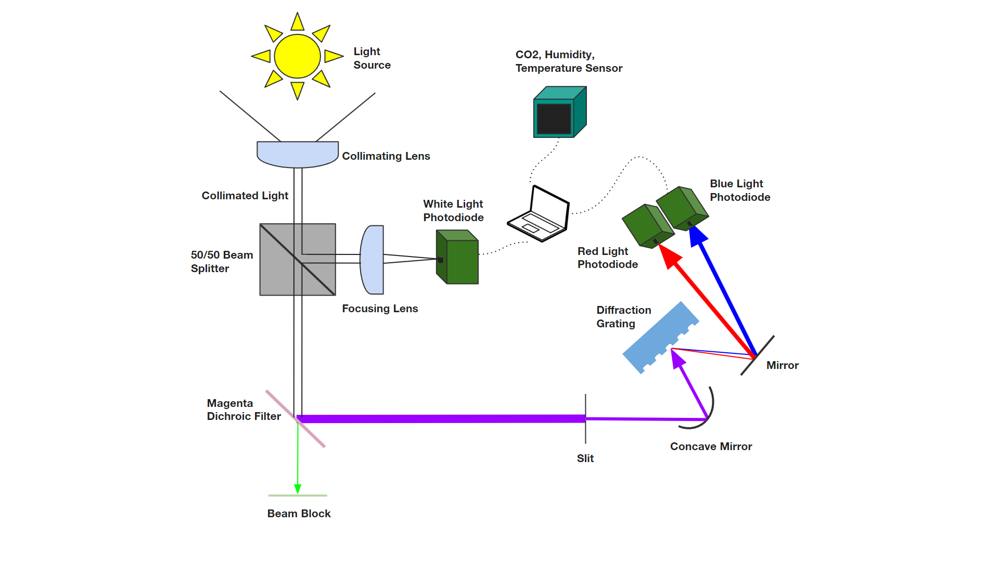
Previous Optical Layout
Maya Sosa
PSE

Slide 10
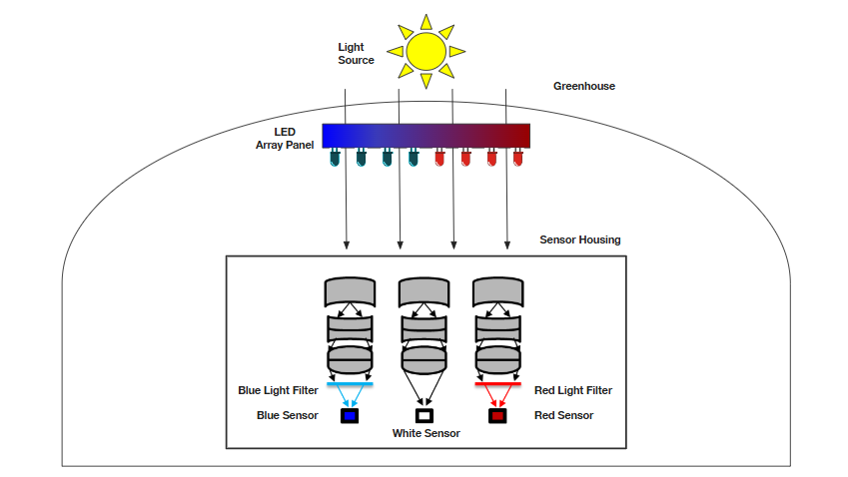
Current Optical Layout
Paul Weiner
PSE
Notes:
This is our current optical layout. Our two light sources are the sun and the LED array panel. Underneath the array, we have three fisheye lenses, which we are using since our last design, which did not take the angle of sun into account didn’t perform well. Underneath two of the lenses, we have have filters for blue and red light. And we have our white light, blue light, and red light sensors.

Slide 11
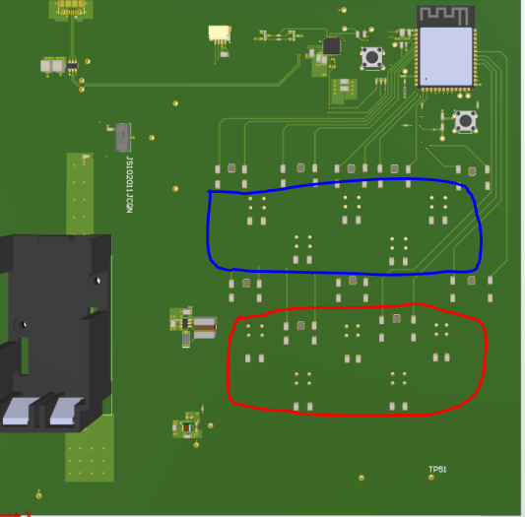
Maya Sosa
PSE
LED Panel
Our advanced goal was to have our greenhouse adjust the necessary parameters to ensure optimal plant health
20 LEDs (10 red, 10 blue) will be used to adjust the blue/red light ratio (on separate PCB)
They will adjust automatically based on what the sensor reads and what the plant needs
This will be presented at showcase to represent greenhouse lighting systems

Slide 12
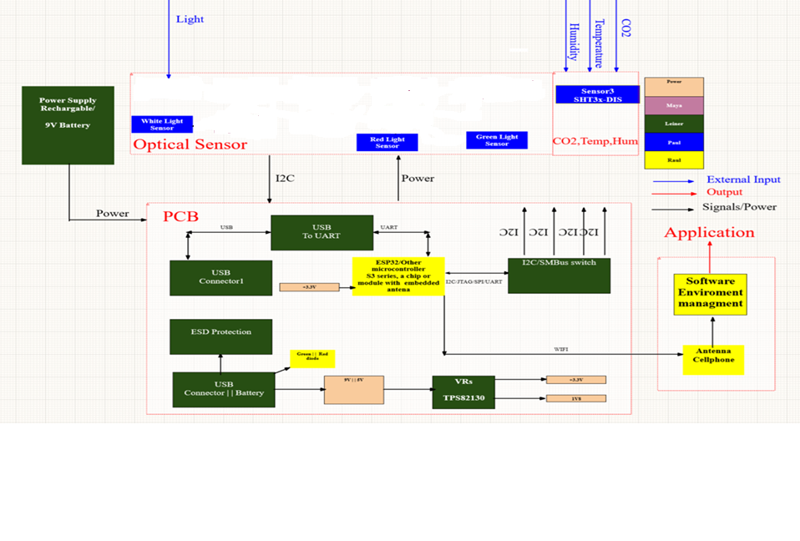

Overall Hardware Diagram
G.E.A Greenhouse Environmental Analyzer
LED Array
Code to Determine Actual Red/Blue Ratio & Take In Desired Ratio
Leiner Suarez
EE
User Input
Application
Fisheye Lens
Fisheye Lens
Fisheye Lens
Sensor3 SHT3x-DIS
Red Filter
Blue Filter
Blue Light Sensor

Slide 13

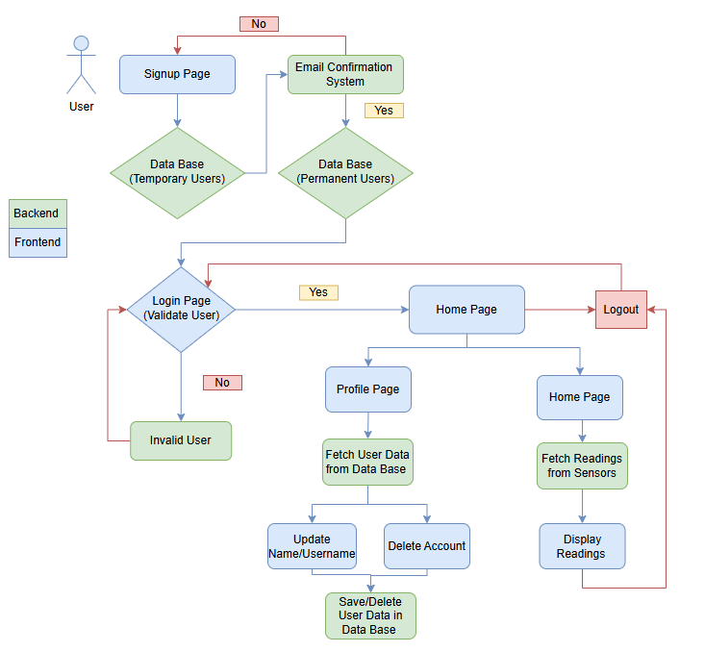

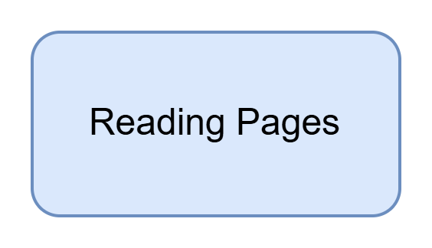
Software Diagram
Raul Graterol
CPE

Slide 14
G.E.A Greenhouse Environmental Analyzer
Paul Weiner
PSE
Table of Engineering Specifications
Specification | Requirement | Unit
The device will have sensors that measure accurately within a certain range. | ±1 | Celsius
 | ±50 | ppm
 | ±10% | RH
 | >10,000 & <100,000 within ±10% | lux
The blue and red LEDs will be able to adjust to the ratio set in the app. | Within ±20% of set ratio
Specification | Requirement | Unit
The maximum frequency shall not exceed the specified amount. | 2.4 or 5 | GHz
Operating System | IOS/Android
The idle power consumption shall not exceed the specified amount. | <1 | Watt
The protective housing material for the sensors will be resistant to temperature and humidity. | ASA
The dimensions of the device shall not be excessive and be portable. | <15”x15”x10” | Inches
The time between updates of the measurements in the app will be realistic. | <40 | Seconds
The device shall not be so heavy that one person cannot lift it. | <15 | Pounds
The device shall use the specified voltage. | 9 | Volts

Slide 15
G.E.A Greenhouse Environmental Analyzer
Technology Comparison and Selection
Paul Weiner
PSE
Light Sensor | Cost | Response Time | Relationship | Measured
Photodiode | $1 | Very Fast | Linear | Current
Phototransistor | $2 | Fast | Linear | Current
Photoresistor | $0.80 | Slow | Non-linear | Resistance

Slide 16
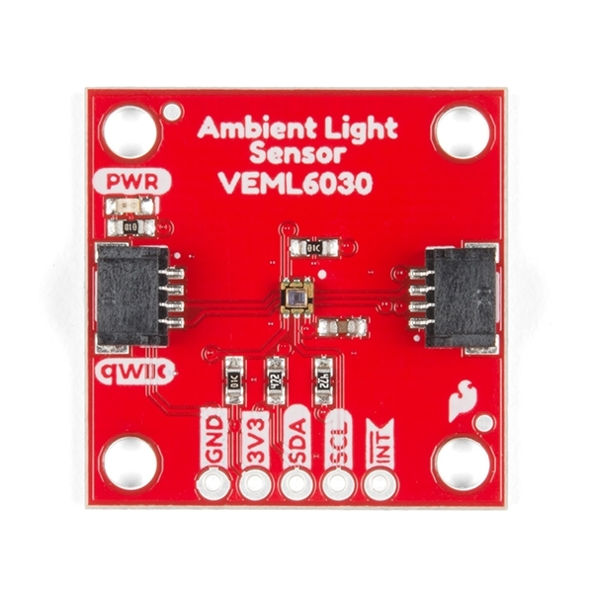
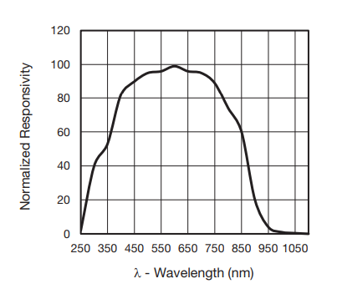
G.E.A Greenhouse Environmental Analyzer
Part Comparison and Selection
Paul Weiner
PSE
Light Sensor | Price | Wavelength | Lux
VEML6030 | $5.95 | Visible/IR | 0lx-120,000lx
TSL2591 | $6.95 | Visible/IR | 188µlx-88,000lx
Mikroe-49674967 | $14 | Visible | <33,000lx

Slide 17
G.E.A Greenhouse Environmental Analyzer
Technology Comparison and Selection
Paul Weiner
PSE
Lens Type | Cost* | Magnification | Use | FOV
Biconvex | ~$29-$51 | 1:1 | Focusing short distance | >180 degrees
Plano-convex | ~$26-$765 | 10:1 or Larger | Light Collimation/Focus | >180 degrees
Fresnel | ~$40-$426 | 10:1 or Larger | Light Collection | >180 degrees
Fisheye | ~$835 (much cheaper ones can be found) | Varies with distance from center of lens | Image Distortion/Large FOV | ~180 degrees
*According to Edmund Optics

Slide 18
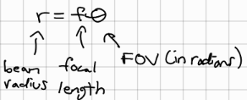
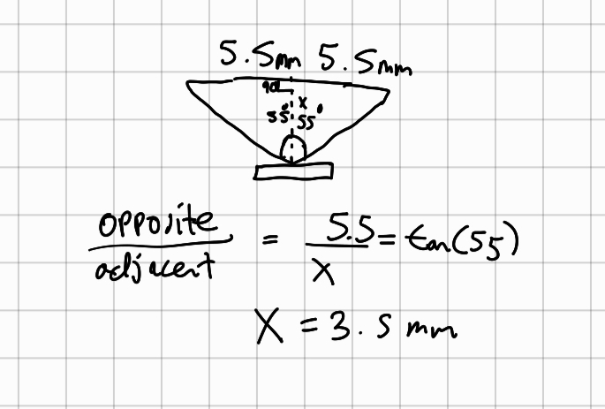
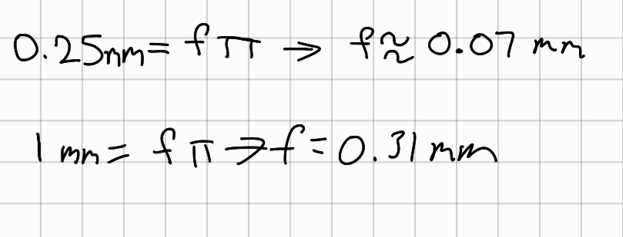
G.E.A Greenhouse Environmental Analyzer
Design Calculations
Paul Weiner
PSE
We know we want a 180̊ FOV so the Sun is always in view.
For fisheye lenses, a 180̊ projection uses the following equation:
As the beam radius gets bigger, so does the focal length, which tells us we want as big of a focal length as possible.
Given that the sensor itself has a FOV of 110̊, we can use trigonometry to determine the distance from the lens needed to capture all the light leaving (the back of the lens has a diameter of ~11mm):
We can calculate the theoretical focal length needed just to fully cover the sensor (0.25mm radius) and the focal length needed at a higher beam radius:
Notes:
When I decided that I needed a fisheye lens, I initially tried calculating how small the focal length would have to be to cover the entire photodiode. In doing that, I found that a focal length of 0.07mm would be necessary, which is not possible. Trying a larger beam radius of 1mm, I gathered that we would need to have as big of a focal length as possible, which lead into my selection of the aliluso fisheye lens, which you will see on the next slide. That’s helpful, but doesn’t take the sensor’s FOV into account. Given that the photodiode has a FOV of 110 degrees, and that the back end of the fisheye lens has a diameter of about 11mm, I used trigonometry to determine that the lens would need to be 3.5mm away from the photodiode so that all the light leaving the lens would be captured.

Slide 19
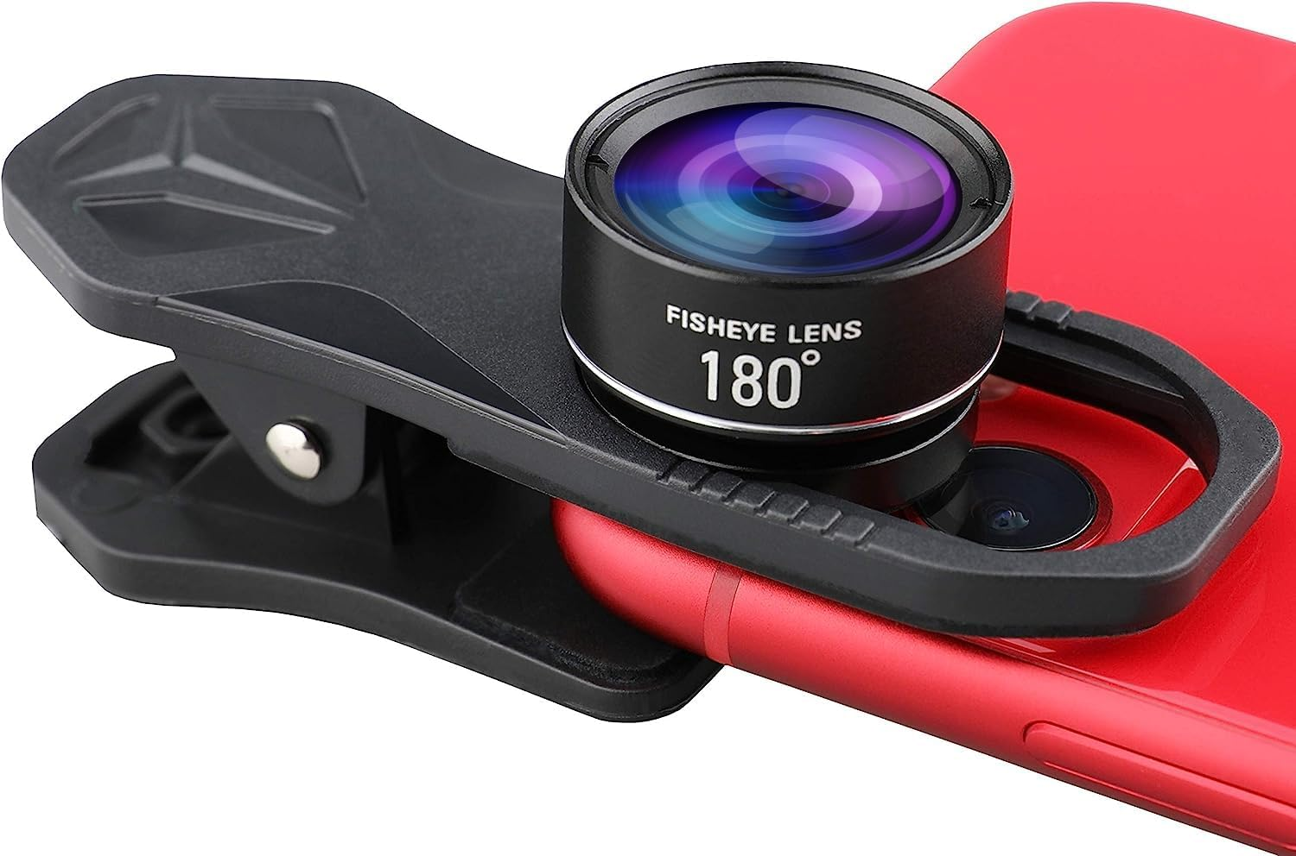
G.E.A Greenhouse Environmental Analyzer
Part Comparison and Selection
Paul Weiner PSE
Lens | Price | Vignetting | FOV | Focal Length
ALILUSO 180° Fisheye Lens | $12.99 | Yes | 180° | 7.5mm
Xenvo Pro Lens | $39.99 | No | Wide Angle <180° | 4.1mm
Edmund Optics 2/3" Format C-Mount Fisheye Lens | $835 | No | 185° | 1.8mm
Notes:
As stated on the previous slide, we chose the aliluso fisheye lens, and this was primarily for two reasons, namely that it has the largest focal length and that it is the cheapest option.

Slide 20
G.E.A Greenhouse Environmental Analyzer
Technology Comparison and Selection
Paul Weiner
PSE
Filter Type | Price* | Mechanism | Angle Dep. | Fluorescence | Wav. Cutoff
Dichroic | ~$73-$144 | Thin-Film Int. | Highly | No | Strong
Absorption | ~$19-$153 | Absorption | None | Yes | Not as strong
*According to Edmund Optics

Slide 21
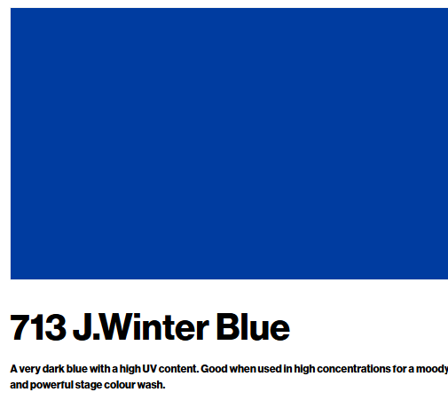
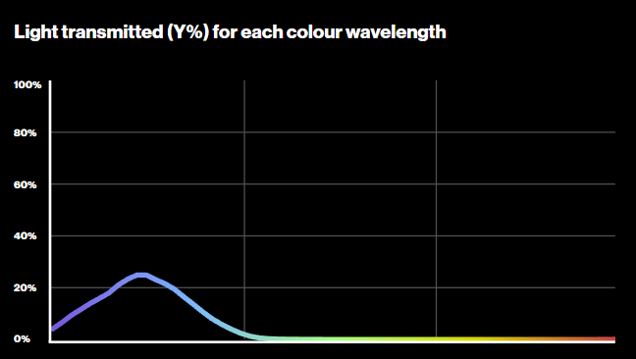
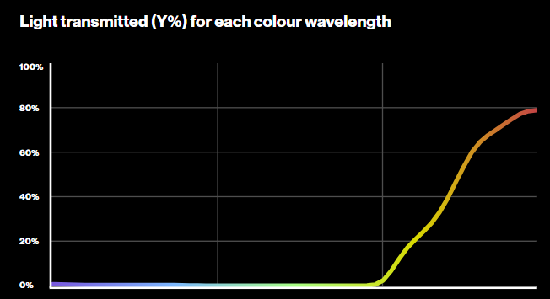
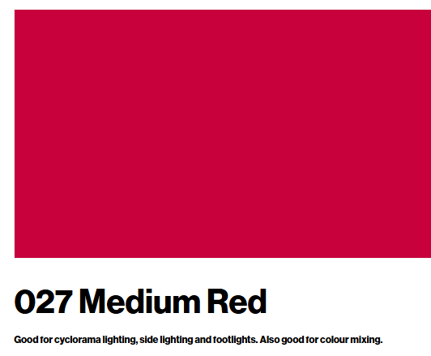
G.E.A Greenhouse Environmental Analyzer
Part Comparison and Selection
Paul Weiner
PSE
Filter | Price | Cutoff Quality
Edmund Optical Cast Plastic | $19 | Red: Great Blue: Poor
Kodak Wratten Filters | $120 | Red/Blue: Amazing
Lee Gels4967 | $11 | Red/Blue: Good

Slide 22
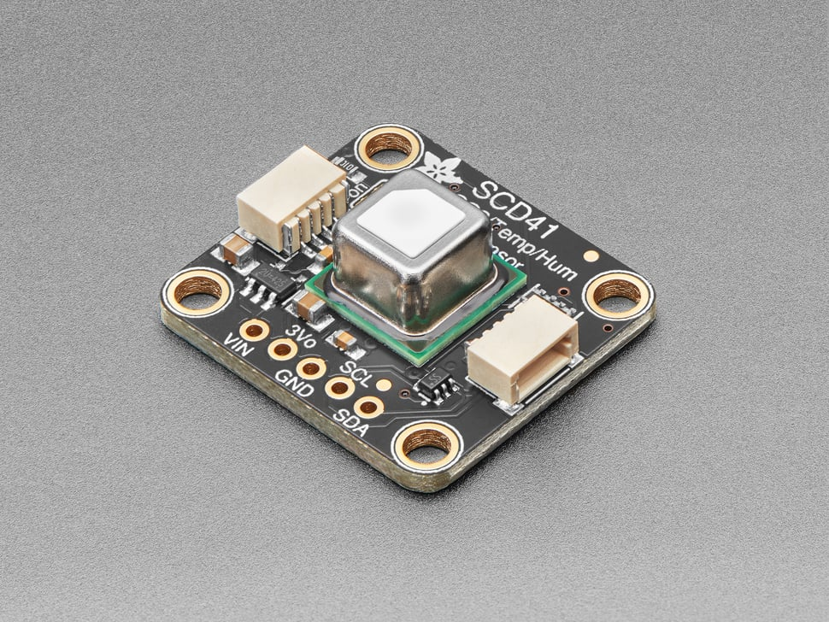
G.E.A Greenhouse Environmental Analyzer
Part Comparison and Selection
Paul Weiner
PSE
Sensor | Cost | Measurement | Accuracy
SCD-41 | $49.95 | CO₂ Temp. Humidity | 400 to 5000 ppm ±9% RH -10 to 60°C
BME688 | $19.95 | Gas (not CO₂) Temp. Humidity Pressure | ±3% RH Other accuracy not considered
SCD-30 | $58.95 | CO₂ Temp. Humidity | 400 to 10,000 ppm 0 to 50°C ±3% RH

Slide 23
G.E.A Greenhouse Environmental Analyzer
Part Comparison and Selection
Leiner Suarez
EE
Voltage regulator technology | Eficiency | Noise | Heat disipation | Power Conservation
Switching | 80%to 95% | EMI noise. Our application is low speed | Do not need heatsing or any mechanical solution | Good power conservation. Suitable for batteries supplied circuits
Linear | 40% to 60% | Low noise. | Need Heatsink. | Lower than switching regulators.

Slide 24
G.E.A Greenhouse Environmental Analyzer
Part Comparison and Selection
Leiner Suarez
EE
Voltage regulator | Cost | Vout | Embedded inductor | Accuracy | Vin Range | I out (max) | Implementation/Design
MAX1836EUT33+T | $8.60 | 3V3 or 5V | No | 10% | 4.5-24V | 250mA | Easy
TPS82130SILR | $5.34 | 0V4 to 17V | Yes | 1% | 3V-17V | 3A | Moderate
TLV700 series | $0.79 | 1V2 to 4V8 | Yes | 2% | 1-5.5V | 200mA | Easy
LMS1585A | $3.32 | 1.5V or 3V3 | Yes | 5% | 4.5-24V | 3A | Easy

Slide 25
G.E.A Greenhouse Environmental Analyzer
Part Comparison and Selection
Leiner Suarez
EE
MCU | Cost | Pins/Density | Embedded Wifi Antena | Vin Range | Implementation/Design
STM32C031x4 | $1.10 | 45/7*7 | No | 2-3.6V | Hard
ATmega48A | $1.80 | 28-pad VQFN | No | 1.8 - 5.5V | Hard
ESP32 S3 WROM 1 | $3.20 | 36 GPIOs- 18.0 × 19.2 × 3.2 mm | Yes | 3-3.6V | Easy

Slide 26
G.E.A Greenhouse Environmental Analyzer
Technology Comparison and Selection
Raul Graterol
CPE
Feature | Bluetooth | Wi-Fi | Infrared | NFC
Range | < 10 meters | < 100 meters | 1–5 meters | < 10 cm
Frequency | 2.4 GHz | 2.4 GHz-5 GHz | Infrared light spectrum | 13.56 MHz
Data Transfer Rate | Up to 3 Mbps | Up to 1 Gbps | < 4 Mbps | < 424 kbps
Power Consumption | 1mW-100mW | 210mW | 10mw | 15mW
Security | Utilizes E0 stream cipher for encryption | Supports WPA, WPA2, and WPA3 encryption | Does not use encryption, making it less secure | Utilizes AES encryption for secure communication
Connection complexity | Easy pairing | Requires network setup | Line of sight must be maintained | Tap/Close Proximity
Scalability | Limited | High (supports multiple device) | Limited | Very limited

Slide 27
G.E.A Greenhouse Environmental Analyzer
Technology Comparison and Selection
Raul Graterol
CPE
Features | Swift | Xamarin | React Native | Flutter
Operating System | iOS | Android & iOS | Android & iOS | Android & iOS
Programming Language | Swift | C# | JavaScript | Dart
Benefits | Optimized for Apple devices, Secure and fast, Modern syntax | Cross-platform native apps, .NET integration, Large library support | Native-like experience, Strong community support, Third-party integrations | High-performance UI, Single codebase, Custom animations
Drawbacks | iOS-only, Not ideal for cross-platform development | Heavy app size, Slower updates compared to native development | Performance issues for complex apps, Limited native modules | Large app size, Steep learning curve for Dart

Slide 28
G.E.A Greenhouse Environmental Analyzer
Technology Comparison and Selection
Raul Graterol
CPE
Features | MongoDB | Apache Cassandra | Firebase | MySQL
Data Model | Document-oriented (JSON-like) | Column-family | Document-oriented (JSON-like) | Table-based (Relational)
Type | NoSQL | NoSQL | NoSQL | Relational (SQL)
Benefits | Flexible schema, High scalability, High availability | Highly scalable, High availability, Fault-tolerant | Real-time updates, Easy to use, Serverless | Mature, Rich query language
Drawbacks | Limited support for complex transactions, Not relational | Complex setup, Not ideal for transactional workloads | Limited querying capabilities, Pricing can increase with usage | Scaling can be challenging, Performance can degrade on large data

Slide 29
G.E.A Greenhouse Environmental Analyzer
Technology Comparison and Selection
Raul Graterol
CPE
Feature | Self-hosting server | Heroku | Vercel | Shared Hosting
Key Advantages | Cost-effective, Full control over setup, Portable with built-in battery backup | Easy deployment, Scales automatically | Optimized for frontend apps, Seamless Git integration | Affordable, Beginner-friendly, No maintenance required
Drawbacks | Limited performance, Not optimized for high-demand loads | Limited free tier, Costs increase with usage | Backend services are limited, Can be costly at scale | Limited resources, Can slow down with high traffic
Best For | Personal projects, Learning, Small-scale hosting | Web apps, Startups, Prototyping | Static sites, Serverless applications | Small websites, Personal blogs
Pricing | One-time cost (hardware & electricity) | $7 per month | $20 per month | $2 - $30 per month

Slide 30
G.E.A Greenhouse Environmental Analyzer
Technology Comparison and Selection
Maya Sosa
PSE
Material | ABS | PLA | PETG | ASA | Nylon
Toxicity | High | Low | Low | High | High
Warping | High | Low | Low | High | High
Durability | High | Low | High | High | High
Heat Resistance | High | Low | High | High | High
UV Resistance | Low | Low | Med | High | Low
Moisture Resistance | High | Med | High | High | Low
Price (per kg) | $15-$20 | $15-$20 | $25-$35 | $25-$35 | $35-$50

Slide 31
G.E.A Greenhouse Environmental Analyzer
Technology Comparison and Selection
Maya Sosa
PSE
Light Source | Efficiency (lm/W) | Lifespan (hours) | Energy Consumption (W) | Heat Emission (W) | Cost (Initial) | Environmental Impact
LED | 80-150 | 25,000-50,000 | 5-20 | 0.5-5 | $2-$15 | Low (No mercury, recyclable)
Incandescent | 10-17 | 750-2,000 | 40-100 | 35-95 | $1-$5 | High (Energy waste, short lifespan)
Fluorescent (CFL) | 50-100 | 8,000-15,000 | 8-30 | 3-10 | $3-$10 | Moderate (Contains mercury)
Halogen | 16-25 | 2,000-4,000 | 30-120 | 30-90 | $2-$10 | High (Short lifespan, inefficient)
High-Intensity Discharge Lights | 75-125 | 6,000-20,000 | 150-400 | 100-400 | $20-$200 | Moderate (Contains mercury, high UV output)
Notes:
High efficiency (80-150 lm/W) – Uses less energy for the same light output.
Very long lifespan (25,000-50,000 hours) – Less frequent replacements.
Low heat emission – Can be placed close to plants without burning them.
Instant on/off – No warm-up time like HID or fluorescent lights.
Environmentally friendly –

Slide 32
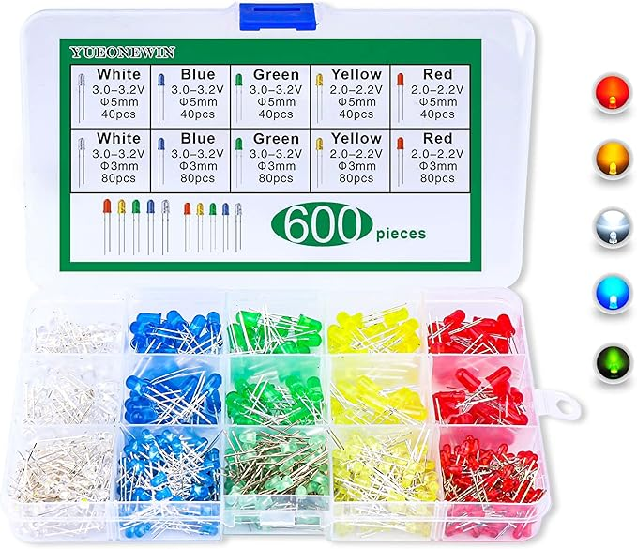
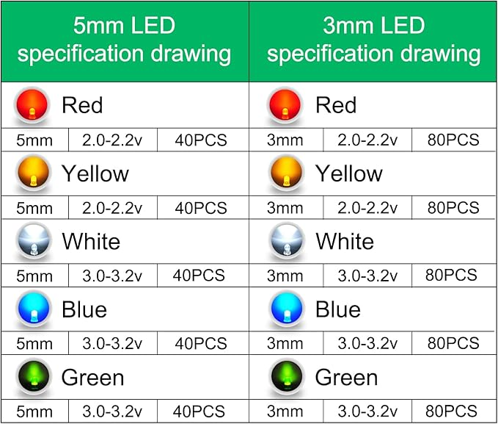
G.E.A Greenhouse Environmental Analyzer
LED Selection
Maya Sosa
PSE
Notes:
High efficiency (80-150 lm/W) – Uses less energy for the same light output.
Very long lifespan (25,000-50,000 hours) – Less frequent replacements.
Low heat emission – Can be placed close to plants without burning them.
Instant on/off – No warm-up time like HID or fluorescent lights.
Environmentally friendly –

Slide 33
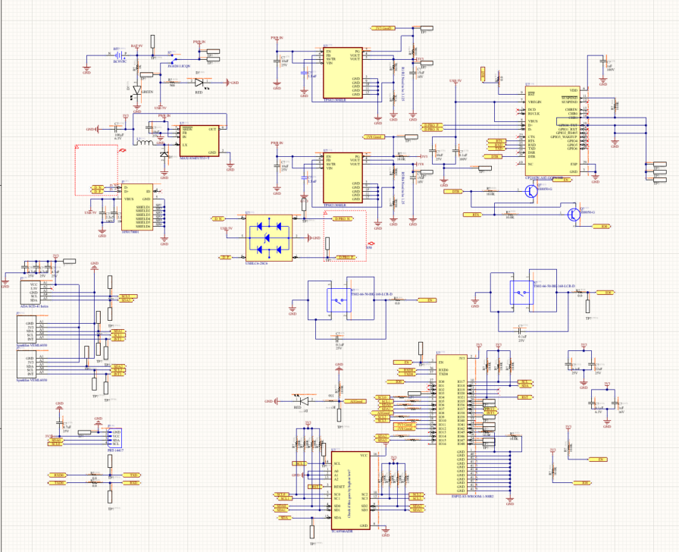
Overall Schematic
G.E.A Greenhouse Environmental Analyzer
Leiner Suarez
EE

Slide 34
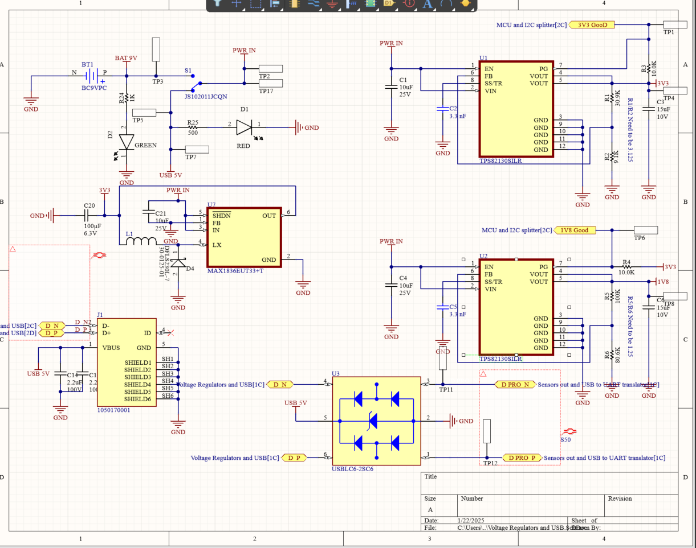
G.E.A Greenhouse Environmental Analyzer
Leiner Suarez
EE
Hardware Design Voltage Regulator and USB Datasheet

Slide 35
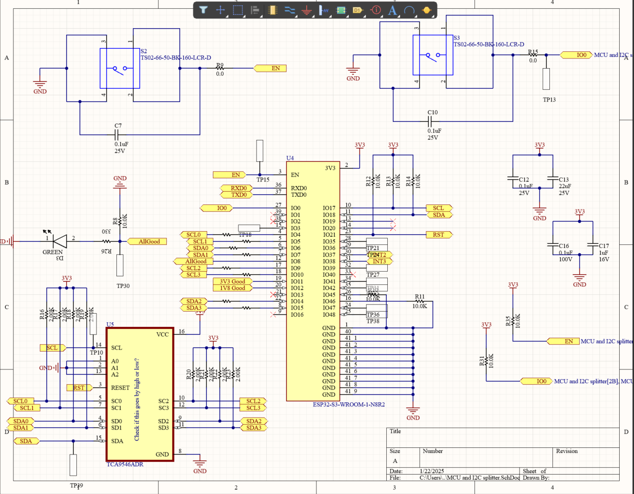
G.E.A Greenhouse Environmental Analyzer
Leiner Suarez
EE
MCU and I2C splitter Datasheet

Slide 36
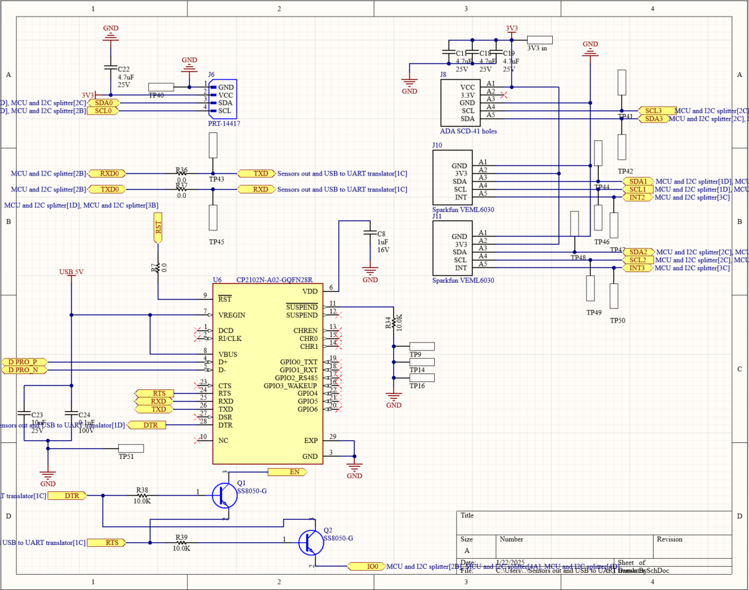
G.E.A Greenhouse Environmental Analyzer
Leiner Suarez
EE
Sensors and USB to UART
Datasheet

Slide 37
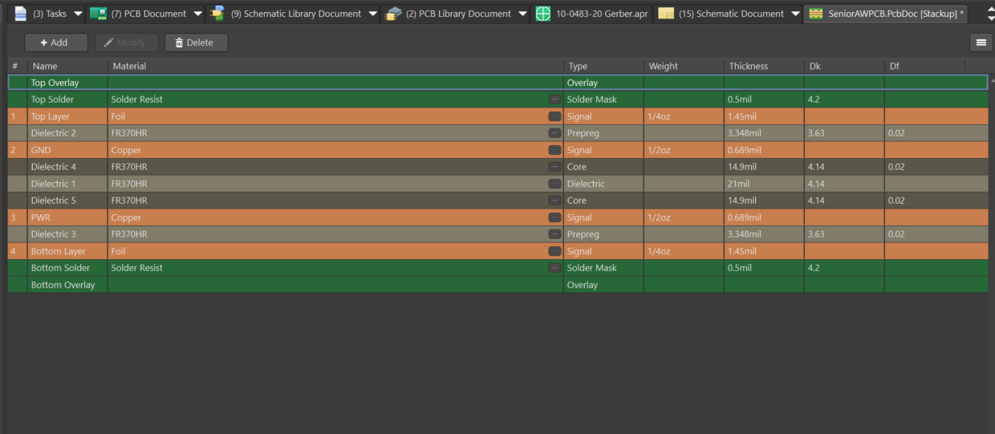
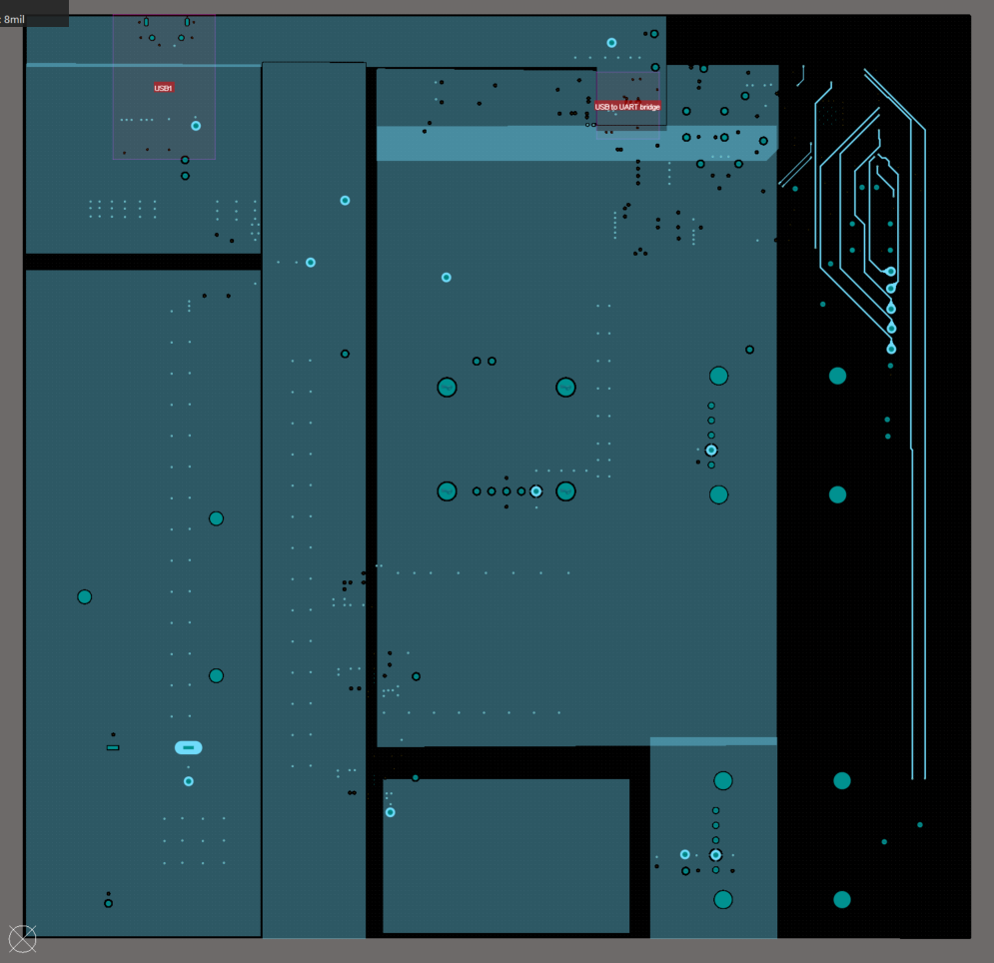
G.E.A Greenhouse Environmental Analyzer
Leiner Suarez
EE
PCB Design Stackup and power plane

Slide 38
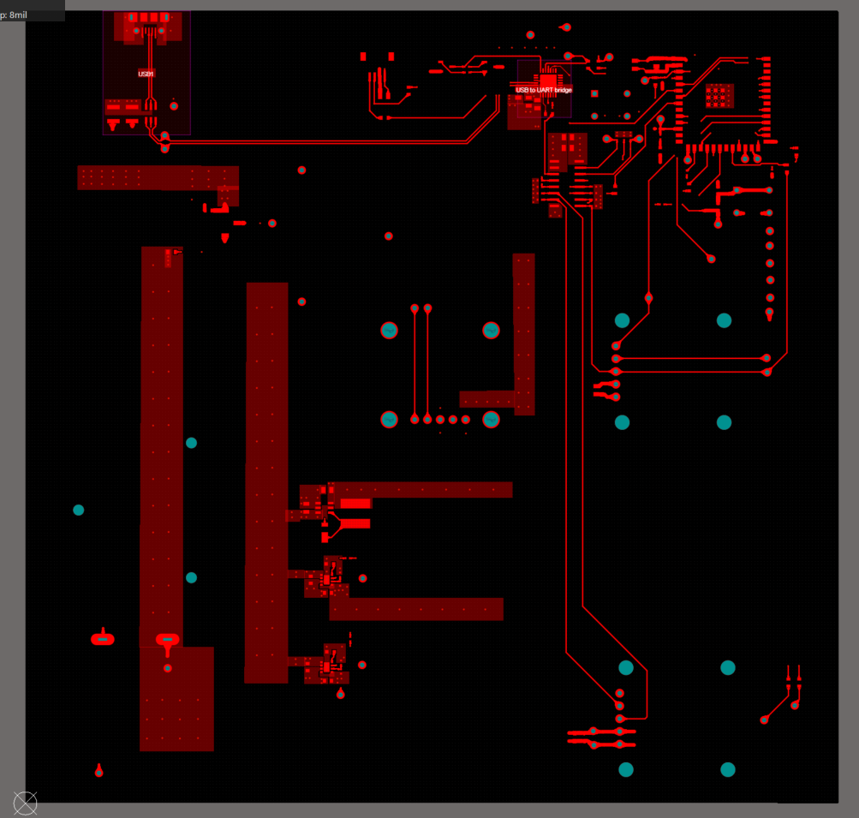
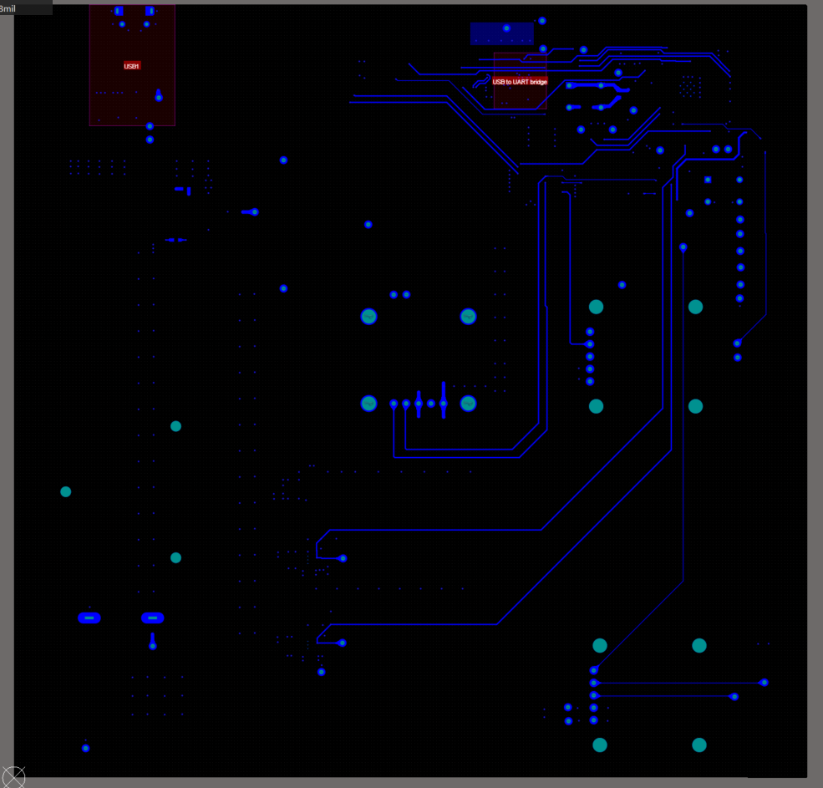
G.E.A Greenhouse Environmental Analyzer
Leiner Suarez
EE
PCB Design Signals Layers

Slide 39
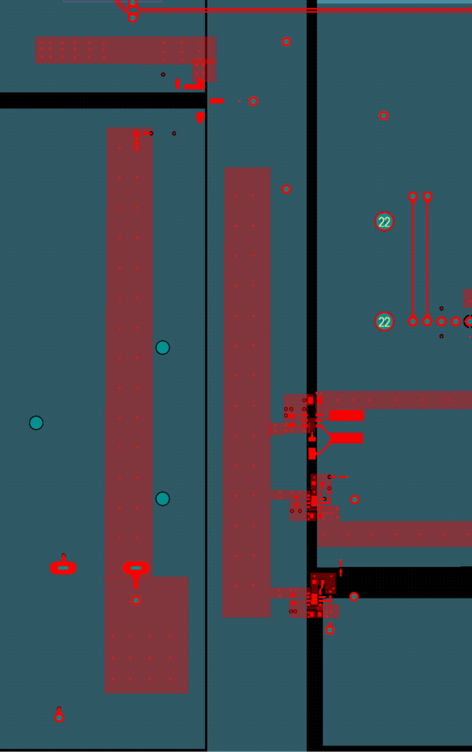
Close look at
the PDN
Leiner Suarez
EE

Slide 40
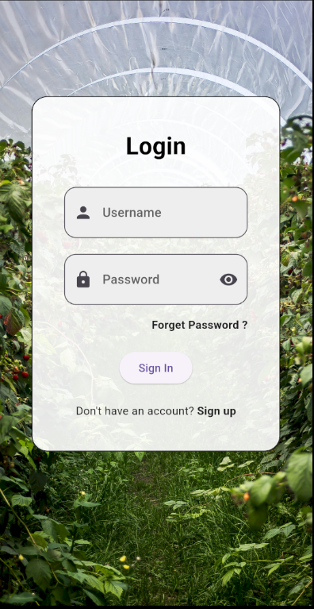
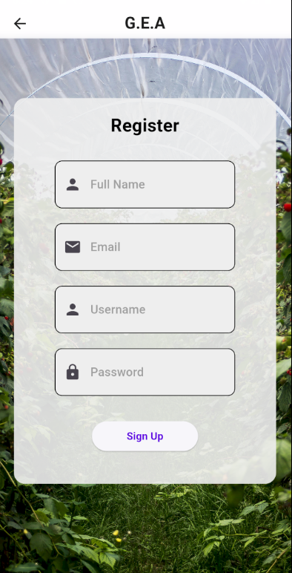
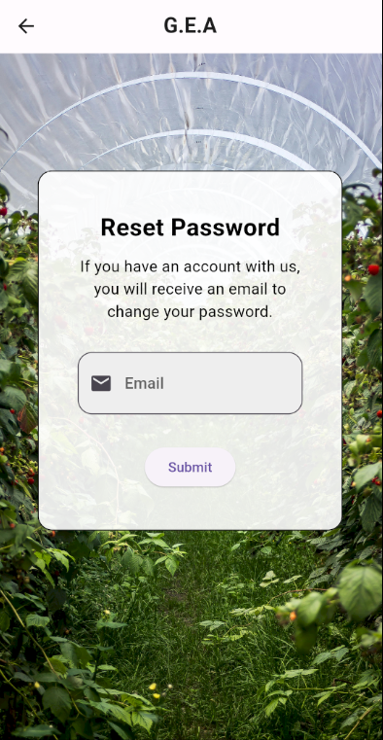
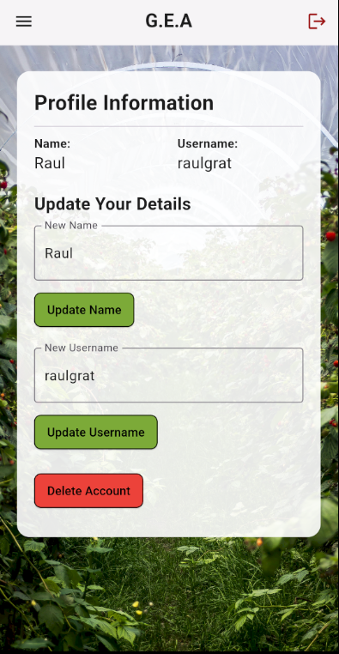
G.E.A Greenhouse Environmental Analyzer
Software Design (UI)
-Handling User Data
Raul Graterol
CPE

Slide 41
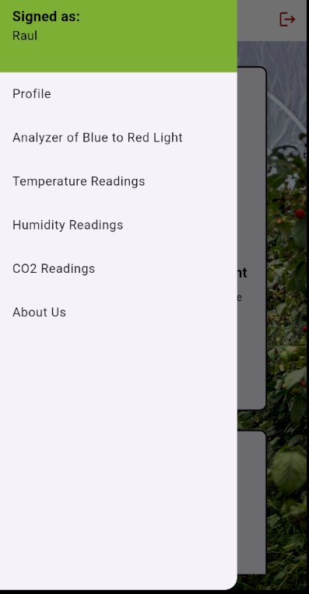
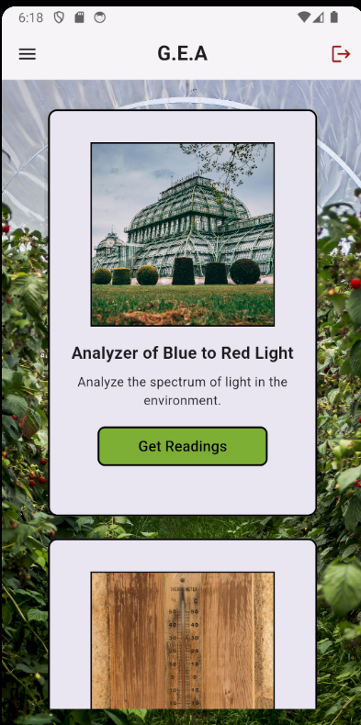
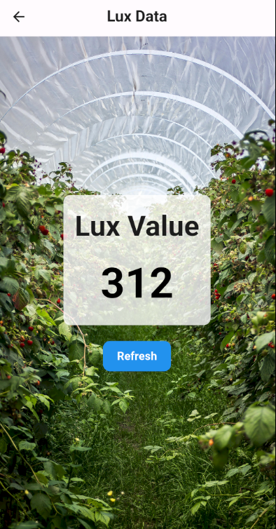
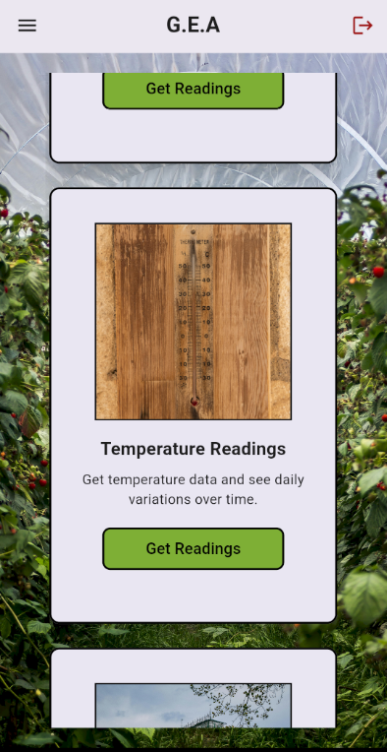

G.E.A Greenhouse Environmental Analyzer
Software Design (UI)
-Handling Readings from Sensors
Raul Graterol
CPE

Slide 42


Prototyping and Testing
Sensor
Maya Sosa
PSE
Aperture
Light Source
Very limited FOV
Movement of the sun not taken into account
Large amount of light loss (lower light levels not accurate)
Measured lux values moved up and down in constant environment
1200 line/mm diffraction grating
Beam Splitter
Collimating Lenses

Slide 43

Prototyping and Testing
Store-Bought
Paul Weiner
PSE
Store-Bought Sensor Lux | GEA Lux | % Difference in Lux
0 | 0 | #DIV/0!
8 | 0 | 100
10 | 0 | 100
22 | 5 | 62.96296296
24 | 15 | 23.07692308
30 | 15 | 33.33333333
31 | 15 | 34.7826087
143 | 135 | 2.877697842
482 | 450 | 3.433476395
2970 | 2705 | 4.669603524
3450 | 3270 | 2.678571429
15250 | 15150 | 0.328947368
59000 | 54505 | 3.960177966
78500 | 75250 | 2.113821138
99710 | 73620 | 15.05221254
GEA
All measurements to be confirmed with a store-bought sensor
Pre-calibration, sensor values were far off
Changing integration time improved range of values, but only to a degree – needed to be multiplied by another value
Sensor now seems to be accurate within 15% above 100 lux (have not tested with filters yet) – need to get closer to 10%
Notes:
The prototyping and testing of our while light lux meter design has been going well. Initially, the values of GEA were far off from the store-bought lux meter but with changes and integration time, we’ve made a lot of progress. At this point, we have mostly been able to get values far below 10% in our specified range of 10,000 lux to 100,000 lux, with difference getting closer to 15% as the lux approaches 100,000. More calibration will need to be done to reduce this number, and calibration of the red and blue sensors will start soon.

Slide 44

Testing PCB functionality
G.E.A Greenhouse Environmental Analyzer
Leiner Suarez
EE
3V3 tested 3.03V
9V tested 9.42V
5V tested 4.95V
1V8 tested 1.79V
Power In: Passed
Led on: Passed
Switch: Worked
Buttons: Worked
MCU: “Led On and Hello world” code worked

Slide 45

Testing sensor integration
G.E.A Greenhouse Environmental Analyzer
Leiner Suarez
EE
-Power on Sensors: Passed
-Communication between singular sensors and MCU: Passed
-WIFI Connection: Passed
-Multiple sensors proper communication: Passed
-QWIC Connection: Passed

Slide 46
Budget/BOM
G.E.A Greenhouse Environmental Analyzer
Maya Sosa
PSE
Expense details | Budget | Number Bought | BOM
Server | $56.00 | 7 | $49.00
Batteries | $20.00 | 10 | $20.00
Humidity, temp, & CO2 Sensor (SCD-41) | $49.95 | Free | $0.00
Light Sensors | $17.85 | 6 | $91.47
Filters | $22.00 | 2 | $31.99
Fisheye Lenses | $39.00 | 1 | $41.49
LEDs | $11.00 | 1 set | $10.00
PCB Fabrication and Assembly | $46.56 | 5 | $289.18
Total Budgeted | $236.36 | Total Bought | $533.13

Slide 47
Progress and Plan for Completion - SD1
G.E.A Greenhouse Environmental Analyzer
Maya Sosa
PSE
Week(s) | Milestone | Finish By | Status
1 | Brainstorming Project Idea and Forming Group | 8/23/2024 | Completed
2-3 | Divide & Conquer Document/Committee Formation | 9/6/2024 | Completed
4-5 | Individual Research & Finalize Idea | 9/18/2024 | Completed
5 | Order Optical Components | 9/20/2024 | Completed
6-8 | Continue Research/Prepare for Midterm Demo | 10/7/2024 | Completed
8 | Midterm Demo (1 Optical Subsystem) | 10/8/2024 | Completed
7-10 | Setting up and Testing Optical Sensor | 10/25/2024 | Completed
8 | PCB Schematic | 10/25/2024 | Completed
8-15 | PCB Design | 11/30/2024 | Completed
8-10 | 60-page Draft Report | 10/25/2024 | Completed
10-12 | 60-page Report Revision | 11/8/2024 | Completed
13-15 | Mini Demo Video/Final Report | 11/26/2024 | Completed

Slide 48
Progress and Plan for Completion - SD2
G.E.A Greenhouse Environmental Analyzer
Maya Sosa
PSE
Week(s) | Milestone | Finish By | Status
1 | Order PCB | 1/10/2025 | Completed
1-4 | Order the Rest of Materials | 1/31/2025 | Completed
4 | Complete Critical Design Review | 2/5/2025 | Completed
1-5 | Application Design/Coding | 2/7/2025 | In Progress
5-7 | Building Prototype | 2/21/2025 | In Progress
7 | SD Showcase Project Summary Form | 2/21/2025
8 | Testing Prototype | 2/28/2025
8-9 | Evaluation/Redesign | 3/7/2025
10 | Midterm Demo Group Meeting | 3/13/2025
10-12 | Building Final Design | 3/28/2025
13-14 | Final Testing and Preparations | 4/11/2025
15 | SD Showcase | 4/17/2025
16 | Final Documentation Submission | 4/22/2025

Slide 49
Progress and Plan for Completion - SD2
G.E.A Greenhouse Environmental Analyzer
Maya Sosa
PSE

Slide 50
Work Distribution
G.E.A Greenhouse Environmental Analyzer
Paul Weiner
PSE
Engineer | Main Assignments Tasks
 | PCB design/ Humidity, Temperature Sensor |  | Application/Website |  | Red/Blue LED Array/Overall Device Housing |  | Light Intensity Sensors
Lead | Leiner |  | Raul |  | Maya |  | Paul
Secondary | Raul |  | Leiner |  | Paul |  | Maya
Engineer | ECE specific Tasks |  |  |  | PSE specific Tasks
 | Schematic Design | PCB layout | Microcontroller code | Application functionality | Light Intensity Sensor Design | Light Intensity Sensor Calibration | LED Array Design | LED Array Programming
Lead | Leiner | Leiner | Raul | Raul | Paul | Paul | Maya | Maya
Secondary | Raul | Raul | Leiner | Maya | Maya | Maya | Paul & Leiner | Raul & Paul

Slide 51
THANK YOU
Questions?

